Slide 1
Recon and OSINT The Pentest Before the Pentest
Rob VandenBrink
rob@coherentsecurity.com

Slide 2
whoami – Rob VandenBrink
IT since 1981, Consulting since 1990’s
Blue Team: Virtualization, Networking, AD, whatever
Red Team: External / Internal pentesting, Web Apps, APIs, AD, Infrastructure, also whatever
Writing: CIS Benchmarks for Palo Alto, Cisco Nexus, Cisco Firepower
“Linux for Networking Professionals”
Internet Storm Center Handler
Sansfire 2023 rob@coherentsecurity.com

Slide 3
How Does your client thing Pentests Work?
Your Client says “attack us like some $evil.haxor!”
You start haxing and pwning, just like in a SANS Class!
That’s what it’s all about right?
How do you identify targets – trust the client?
How do you cost out the project?
What’s the scope – when is the project “done”?
Sansfire 2023 rob@coherentsecurity.com

Slide 4
When the Party is Over ..
Did you attack all the right targets?
Sure, you haxed www.cust.com .. what about payments.cust.com and e-commerce.cust.com on the same box?
Did you leave some great on prem or cloudy targets untested?
Maybe that marketing NoSQL box with no creds?
The DEV box nobody got told about?
Did you attack some third party by accident?
Sansfire 2023 rob@coherentsecurity.com

Slide 5
Reconnaissance
This why recon is the first phase (after initial scope)
This is where you “find” the various assets your client didn’t tell you about or doesn’t know about
Usually a quick recon to help size / price the project
Then a more in-depth recon after you get sign-off
Getting recon right sets the course for the project
Getting recon wrong sinks the ship
Sansfire 2023 rob@coherentsecurity.com

Slide 6
Where to Start?
Certificate Transparency is a decent place to start
But isn’t everyone using wildcards-even LetsEncrypt?
Maybe your client isn’t so wild though
Cert transparency reaches back to “the olden days”, in this case old data is gold data!
Also, multiple wildcards per cert is a thing these days – finding a second domain in a cert is awesome!
Sansfire 2023 rob@coherentsecurity.com

Slide 7
Demo - Certs
NMAP:
nmap –Pn –sT –p443,xx <site> --script ssl-cert
Cert Transparency:
https://ui.ctsearch.entrust.com/ui/ctsearchui
https://crt.sh/
Sansfire 2023 rob@coherentsecurity.com

Slide 8
Port Mapping without Mapping
If you’ve ever had to come up with “whats on that box” instantly during a meeting, SHODAN is the answer!
Ports and services by IP
Easy web interface
API of course is the way to scale this
Sansfire 2023 rob@coherentsecurity.com

Slide 9
Demo – Shodan API
https://api.shodan.io/shodan/host/<host ip>?key=<API Key>
(your API key is on your shodan account page)
Let’s look at isc.sans.edu
Sansfire 2023 rob@coherentsecurity.com

Slide 10
Passive DNS – Mining by IP Address
If we have a target (or offending) IP, what DNS name(s) does it have, now or in the past?
Useful in (just for starters): | log analysis forensics enriching SIEM data
Or if you have an IP in a pentest, what OTHER sites / services are on that IP?
Sansfire 2023 rob@coherentsecurity.com

Slide 11
More on Mining by IP Address
Tools (also, just a starter list): | Host Certificates - Nmap (ssl-cert script), openssl, certutil etc IPINFO (ASN, location) / whereis DNS Dumpster / Hackertarget Cisco Umbrella VirusTotal passive DNS Ipinfo, circl.lu
Sansfire 2023 rob@coherentsecurity.com

Slide 12
API Calls against a specific IP
API Calls for Passive DNS:
Cisco: investigate.api.umbrella.com//pdns/ip/<target ip>
VT: www.virustotal.com/vtapi/v2/ip-address/report
DNSDumpster: api.hackertarget.com/reverseiplookup/?q=<target ip>&apikey=<API KEY> (API Key is optional for low volumes)
Circl.lu: <userid>:<pwd> -X GET "https://www.circl.lu/pdns/query/<target ip>" -H "accept: application/json" | jq
Sansfire 2023 rob@coherentsecurity.com

Slide 13
Demo – IPINFO / Circl.lu/ Umbrella
Ipinfo for isc.sans.edu IP address
Circl.lu - - free, but less info behind the API
Umbrella dump for isc.sans.edu IP address
Sansfire 2023 rob@coherentsecurity.com

Slide 14
More Passive DNS – Mining by DNS Zone
Find all hosts in the domain
Maybe hosts that your client doesn’t know about
Maybe hosts that have been retired and are gone, but give you clues to look at current hosts with ?
But wait, you can’t just do a zone transfer in 2023 (can you?)
Sansfire 2023 rob@coherentsecurity.com

Slide 15
Passive DNS – Who Ya Gonna Call?
Passive DNS repo’s that allow queries
DNS Dumpster / Hacker Target
OpenDNS (Cisco Umbrella)
Shodan (not as good as umbrella)
Use the API, Luke!
Sansfire 2023 rob@coherentsecurity.com

Slide 16
DNS – Mining by DNS Zone
Shodan:
https://api.shodan.io/dns/domain/<zone>?key=<api key>
Cisco Umbrella (OpenDNS):
https://investigate.umbrella.com/subdomains/%1?parentcategories=false?offsetName=<zone name>" -H "Authorization: <api token>" -H "Content-Type: application/json" | jq
Umbrella gives us more info, but returns records in groups of 20, so we need a loop
Sansfire 2023 rob@coherentsecurity.com

Slide 17
Demo – Dump DNS Zone from Passive DNS
Shodan
dnsdumpster
Umbrella (Dnsdump.cmd) sans.edu
This is where we find that umbrella pulls this info in groups of 20
How to fix – add a loop! Dnsdump.ps1
Sansfire 2023 rob@coherentsecurity.com

Slide 18
Combine IP Address and Zone
What ELSE is on that host?
Maybe a older version or a not-ready-for-prime-time new version behind the real host?
With multiple web hosts, each might as well be different hosts as far as a pentest goes
Sansfire 2023 rob@coherentsecurity.com

Slide 19
The Other Side of the Coin
Can you use this on the Blue Team side?
Definitely – common Log/SIEM/SOC stuff:
Turn IP’s into hostnames
From IP’s, get countries
From IP’s get domains, then pivot over the domain
(Zeke) From traffic, capture IPs & certs and do all of the above
Sansfire 2023 rob@coherentsecurity.com

Slide 20
Usernames / Email
Linkedin to harvest user names
Corporate site to harvest emails / establish email format
Theharvestor
Emailharvestor
Rocketreach API (fairly cheap)
Other Marketing APIs ($$$)
Sansfire 2023 rob@coherentsecurity.com

Slide 21
Demo - Let’s Do the Thing!
Theharvestor
Emailharvestor (this one takes a while!)
Checkusernames.com (not so useful these days)
Rocketreach (results vary, $$ but can eval)
Disappointing results?
Sansfire 2023 rob@coherentsecurity.com

Slide 22
Usernames / Email - LinkedIn?
Back in the day, this call would give you a decent list:
http://api.linkedin.com/v1/people-search?company-name=<name>
Sadly, that original API is long deprecated and gone
Need to be an “approved partner” to use the new API
Manual scraping still works for small-ish target companies
Or, happily, some of those “approved partners” have (paid, but reasonable) APIs you can use
Proxycurl for instance:
Sansfire 2023 rob@coherentsecurity.com

Slide 23
curl -G -H "Authorization: Bearer ${YOUR_API_KEY}" \ 'https://nubela.co/proxycurl/api/linkedin/company/employee/search/' \
--data-urlencode 'linkedin_company_profile_url=https://www.linkedin.com/company/microsoft/' \
--data-urlencode 'keyword_regex=ceo|cto' \
--data-urlencode 'page_size=100' \
--data-urlencode 'country=us' \
--data-urlencode 'enrich_profiles=enrich' \
--data-urlencode 'resolve_numeric_id=false’
(https://nubela.co/proxycurl/docs#company-api-employee-search-endpoint)

Slide 24
Usernames / Email – Other Resources
Jigsaw (jigsawsecurityenterprise.com)
Grep names or domains out of password dumps
Passwords are usually a bust, but the usernames never change
Corporate website
cewl is an old-gold tool for this!
Sansfire 2023 rob@coherentsecurity.com

Slide 25
Distro’s? Even more Resources?
Kali has a lot of this tools built in
Recon-NG Framework
OSINT Framework
SecurityTrails API (more DNS)
SpiderFoot
In all Recon Distro’s, BYOK (Bring your own API Keys)
Sansfire 2023 rob@coherentsecurity.com

Slide 26

How good can this get?
Do any of these look like:
Dev hosts?
Abandoned dev hosts?
Sansfire 2023 rob@coherentsecurity.com

Slide 27
How good can this get? – Better!
Abandoned dev hosts ..
.. that $devs had told $IT had been decommissioned ..
.. hosted on a provider that the contract was cancelled on 5 years ago?
Sansfire 2023 rob@coherentsecurity.com

Slide 28
How good can this get? – Yes, it gets Better!
Sites in $dev, but before $security has looked at them?
Dev hosts (current or abandoned) with real customer data on them or behind them ?
Sansfire 2023 rob@coherentsecurity.com

Slide 29
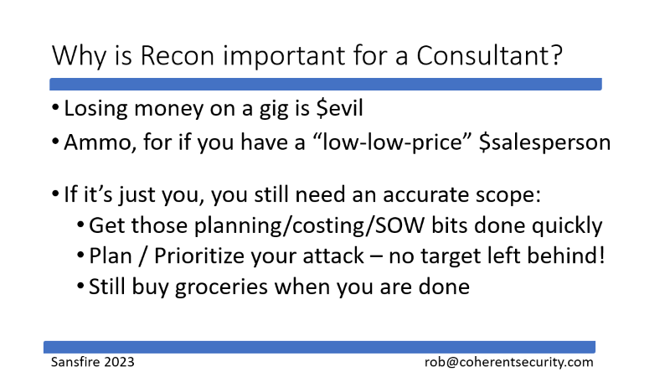
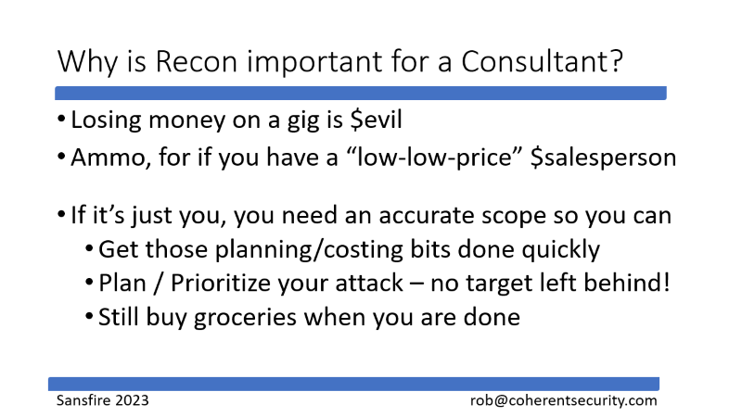
How good can this get? – Winner Winner!
Marketing hosts with real customer data?
.. Running couchdb or some other NoSQL thing
.. With a blank or default admin password?
Sansfire 2023 rob@coherentsecurity.com

Slide 30
Why is Recon important for a Consultant?
Losing money on a gig is $evil
Ammo, for if you have a “low-low-price” $salesperson
If it’s just you, you still need an accurate scope:
Get those planning/costing/SOW bits done quickly
Plan / Prioritize your attack – no target left behind!
Still buy groceries when you are done
Sansfire 2023 rob@coherentsecurity.com

Slide 31
Questions?
Questions?
Stories? What cool things have you found in recon?
Sansfire 2023 rob@coherentsecurity.com

